Slide 1
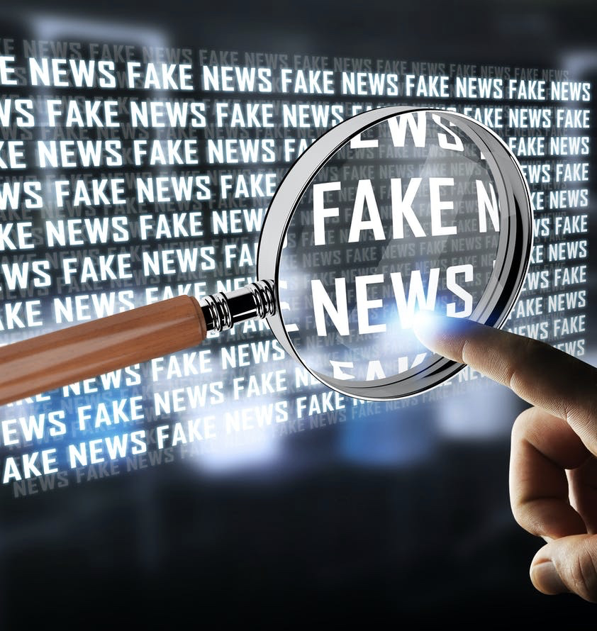
Fake News Detection
Group-SC05

Slide 2
Problem Statement
With the current usage of social media platforms, consumers are creating and sharing more information than ever before, some of which are misleading with no relevance to reality.
Automated classification of a text article as misinformation or disinformation is a challenging task.
Even an expert in a particular domain has to explore multiple aspects before giving a verdict on the truthfulness of an article.

Slide 3
Problem Statement
We got empathized with the customers and are also in person affected by this which made our work easy to an extent
In this work, we propose to use machine learning ensemble approach for automated classification of news articles.
Our study explores different textual properties that can be used to distinguish fake contents from real

Slide 4
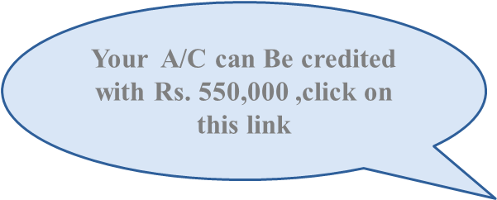
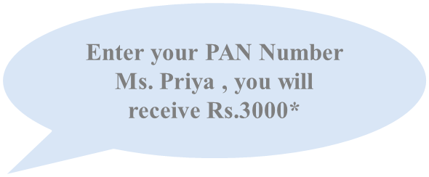
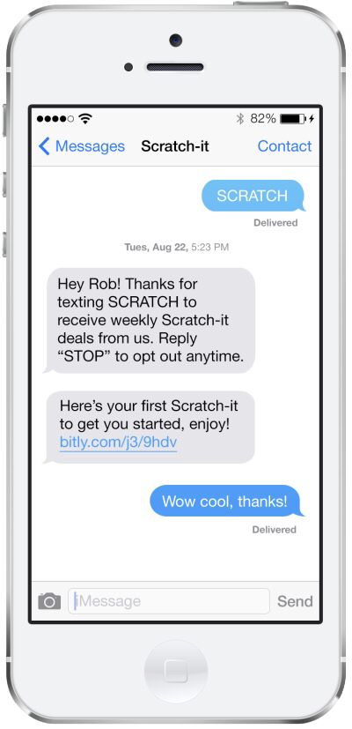


Example

Slide 5
Empathy
Fake news and disinformation can covertly modify the behavior of individuals. It can do this by manipulating implicit attitudes and emotions.
Current mitigation methods do not prevent behavior modification. It is urgent to address this threat to democracy and individual autonomy.
The fact that if a lie is repeated enough times, you’ll begin to believe it’s true.
Though people’s initial belief in false information can be difficult to change, some evidence suggests that warnings about false information can reduce belief in false claims or prevent the uptake of misinformation.

Slide 6
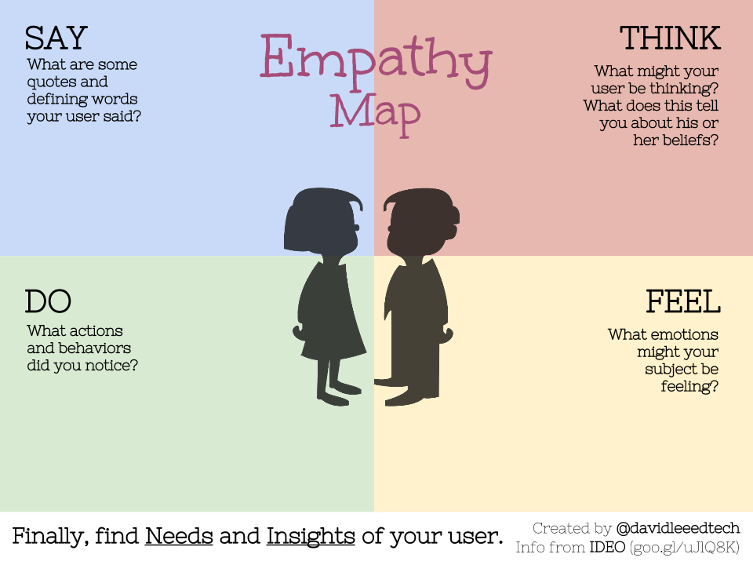
There is a lot of misinformation in social media
But, It is beneficial too.
How to find if the news is real or fake
Just, ignore those thoughts
Try to reach out somebody
Worried
Distressed
Confused

Slide 7
Motivation
Purposely misleading a story is ‘fake news’. Now a days fake news is a major problem in the society.
People started loosing faith in news on social media. As most of our lives are spent interacting online through social media platforms ,more and more people tend to seek news from social media rather than news organizations or news papers and further it is easy to share and discuss the news with friends or other readers on social media.

Slide 8
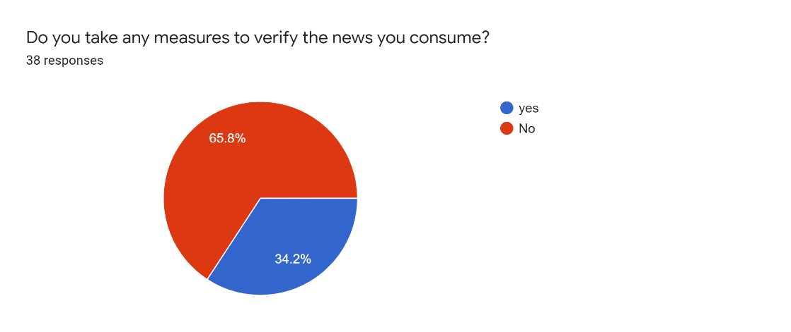
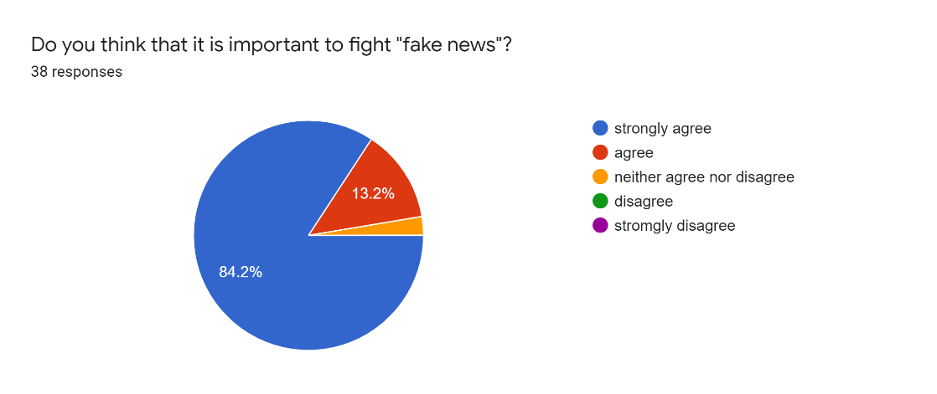
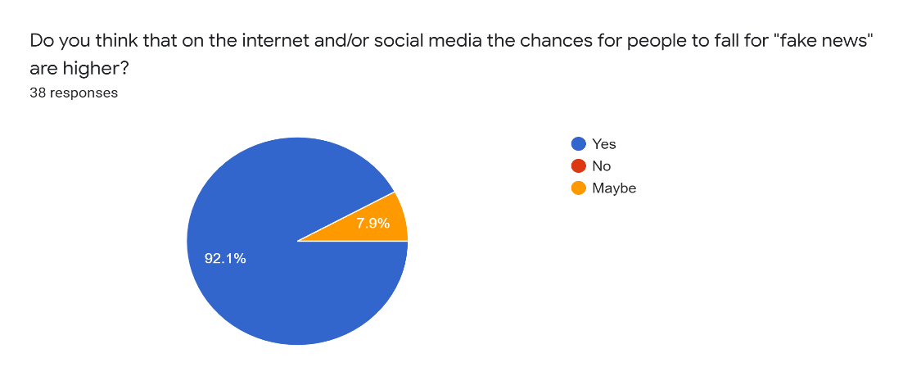
Motivation

Slide 9
Motivation
Though there are many advantages provided by social media the quality of news on social media is lower when compared to traditional news organization.
The extensively spread of fake news can have a serious negative impact on individual and society
After analyzing the survey results we understand that the people are concerned and worried by fake news but are really not trying to verify whether the news is real or fake.
And most of them believed that it is social media which is playing a key role in this phenomena

Slide 10
Defining Insights
Primary needs
Finding the spam websites
Misleading content
Fabricated content
False context
Imposter content

Slide 11
Defining Insights
Seconary needs
Helps users to spam filters on system.
Will be able to get information about clicks which they have clicked.
Latent needs
We need users to be smart enough to understand what is spam and what is not . Also we need them not to blindly believe what is sent over internet.

Slide 12
Research
Fake news has been defined and the target has been set, it is now needed to analyze what features can be used in order to classify fake news. Starting by looking at news content, it can be seen that it is made of four principal raw components:
Source: Where does the news come from, who wrote it, is this source reliable or not.
Headline: Short summary of the news content that try to attract the reader.
Body Text: The actual text content of the news.

Slide 13
Research
Image/Video: Usually, textual information is in agreement with visual information such as images, videos or audio.
Features will be extracted from these four basic components, with the mains features being linguistic-based and visual-based. As explained before, fake news is used to influence the consumer, and in order to do that, they often use a specific language in order to attract the readers.
On the other hand, non-fake news will mostly stick to a different language register, being more formal. This is linguistic-based features, to which can be added lexical features such as the total number of words, frequency of large words or unique words.

Slide 14
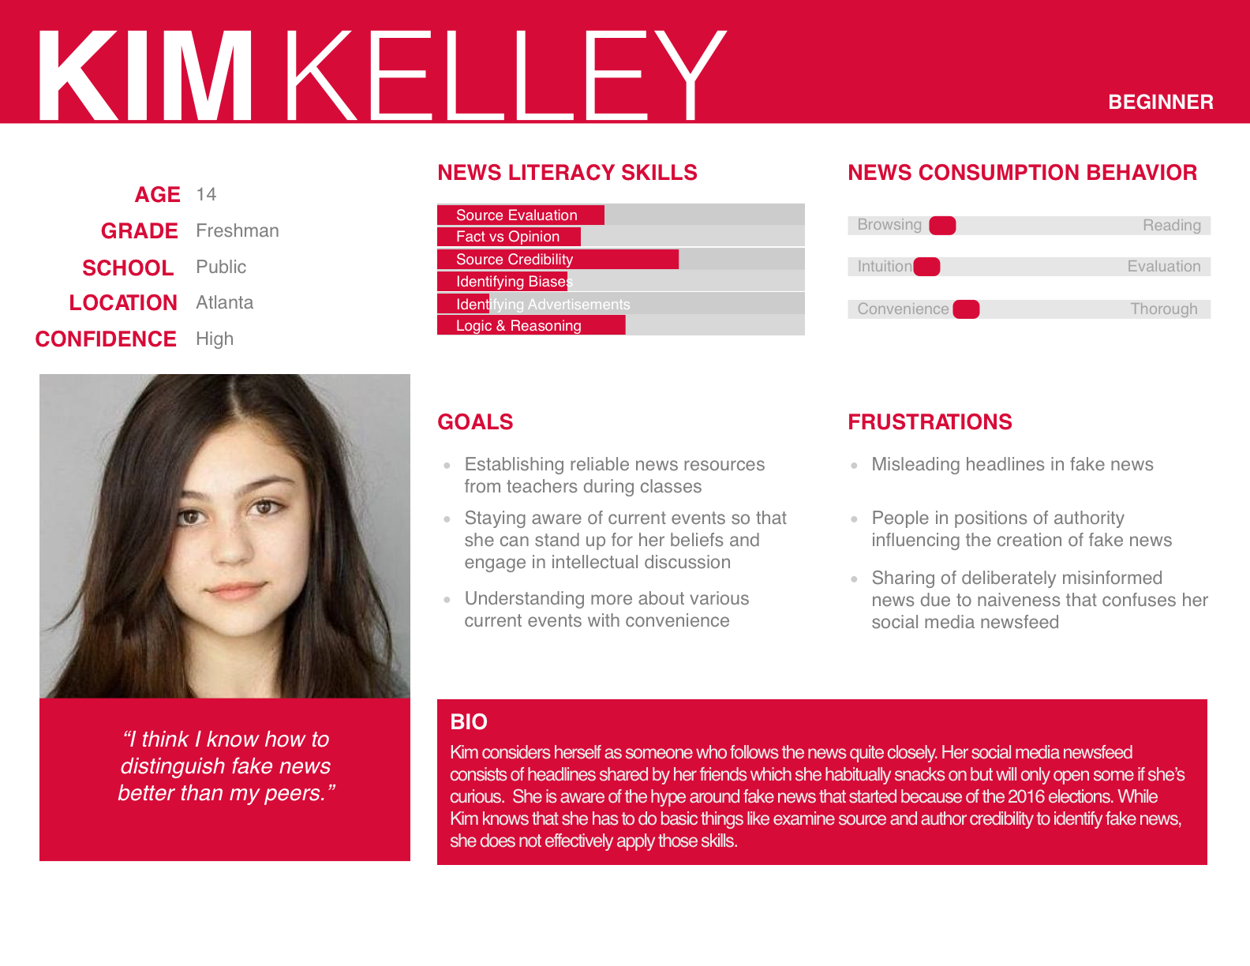
USER PERSONA
Three different personas are created based on the level of news literacy skills.

Slide 15
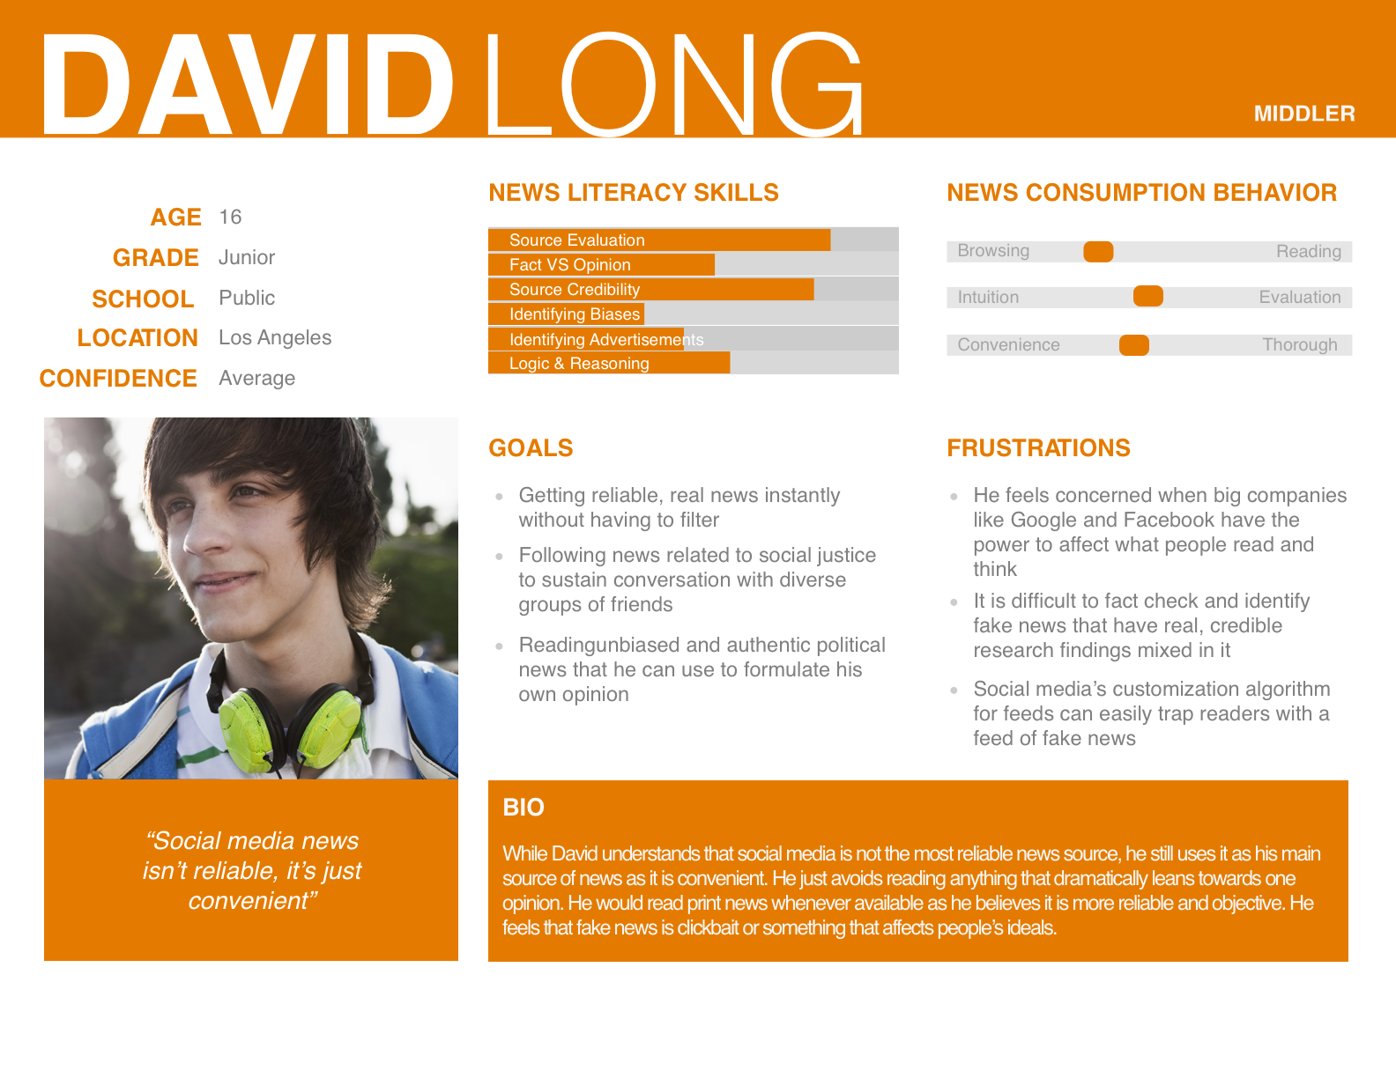
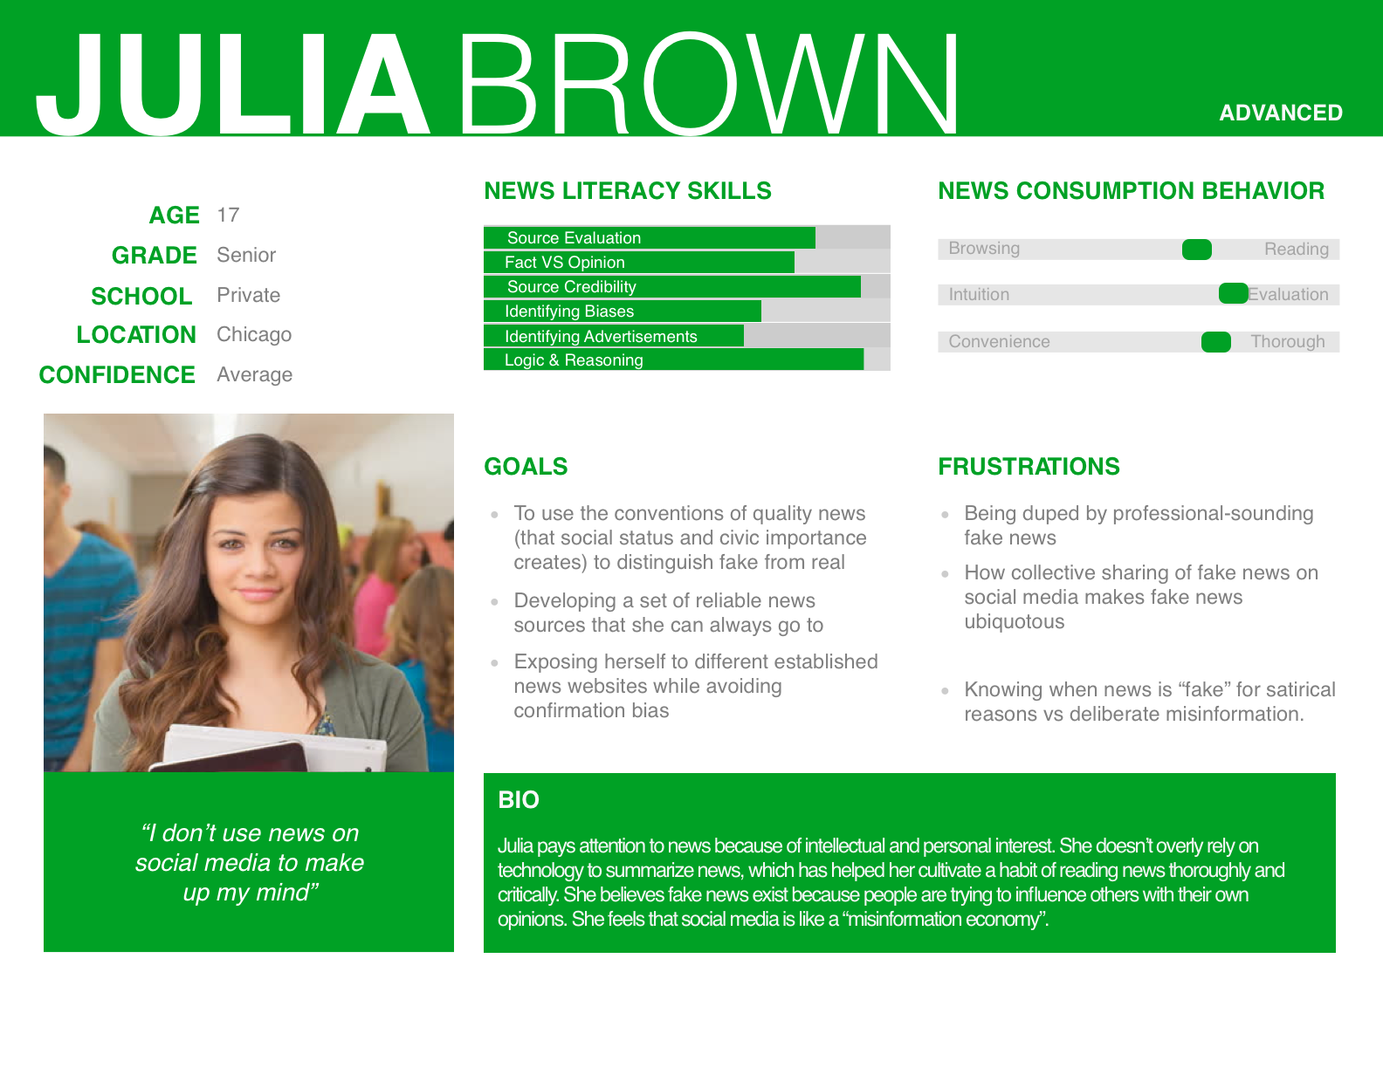
USER PERSONA

Slide 16
Service Experience Cycle
We conducted a survey among people who use social media widely( Students).
Pain points
Misinformation can lead to something which is really dangerous sometimes.
They don’t have time to verify the news articles.
Gain points
This platform can get clarification to them.
It will cut off the time spent on reaching out to somebody else.
Real information is always worthy.

Slide 17
Service Experience Cycle
Collecting data widely
Providing final verdict if the news is real or fake
Running Machine Learning algorithms

Slide 18
Ideation
After understanding the problems and brainstorming we have discussed about
What is it?
Who is responsible?
What is PR’s role to tackle?
Do we trust?
Finally, came up with a solution to use Machine Learning algorithms to classify real and fake news
These machine learning algorithms can be run against like minded content

Slide 19
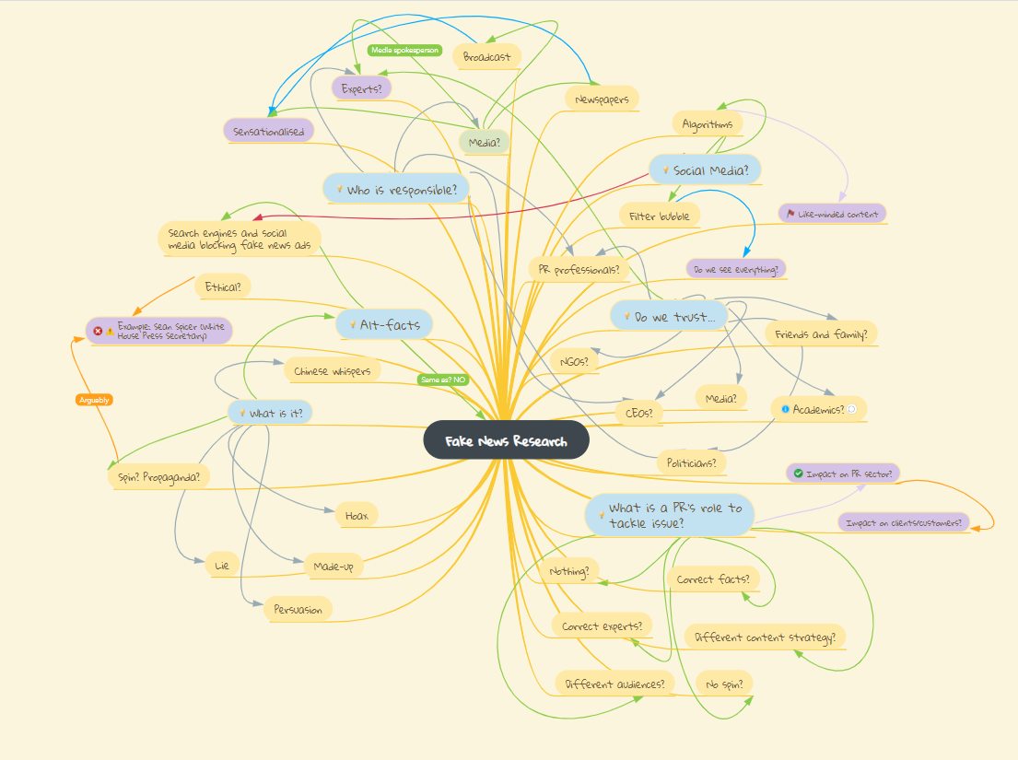
Ideation Method- Mind Map

Slide 20
Solution Prototype
The solution gives us if the news is real or fake after running it on five algorithms.
Algorithms used are
Logistic Regression
Decision Tree Classifier
Gradient Boosting Classifier
Random Forest Classifier
Linear Super Vector Classifier

Slide 21
Solution Prototype
Colab Notebook: https://colab.research.google.com/drive/1RAiWivFbFT0Ouj85l8C7Nbx5PV8VsLkv
This can be further improved by developing a website.
UI can be very helpful to the user by giving the verdict within no time

Slide 22
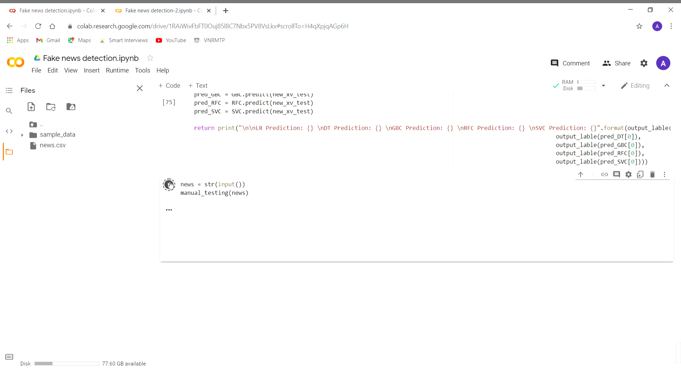

Slide 23
Real Win Worth
There is dire need for this product
There is a clear idea and concept of product
There are similar products in the market
With appropriate management and also understanding the market can make us win
This is a zero budget product so far and in future UI improvements and backend storage may take some cost
Launching this product may improve our standards and it is approvable

Slide 24
Team Experiences
Initially we faced problems for associating with teammates.
But gradually, despite of the online curriculum, we were able to contact each other without any inhibitions
We used google meet for discussions on problem selection and the ideation method.
Each of us got involved in every task and finally developed a solution as a result of our teamwork
This experience will be one of its kind for everyone of us.

Slide 25
Thank you

